Slide 1

A/B TESTING FOR GLOBOX MAIN WEBPAGE
Tendai Zvarevashe

Slide 2

CONTEXT
Promote food and drink offering
Increase conversion and or revenue
Total number of users in the experiment 48943
Duration 13 days

Slide 3
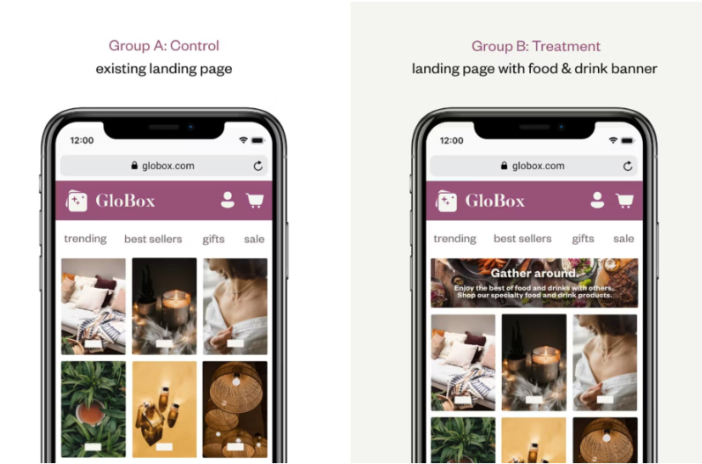
An experiment was run on mobile website to highlight key products in the food and drink category
The banner aims to increase conversions and or impact on revenue, which are tracked when users make purchases.

Slide 4
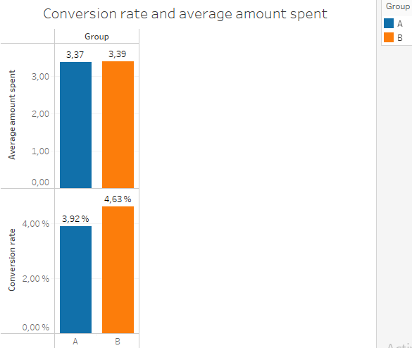
Conversion rate
Group A
24343 Users
Conversion rate 3.92%
Average amount spent $3.37
Group B
24600 Users
Conversion rate 4.63%
Average amount spent $3.39

Slide 5
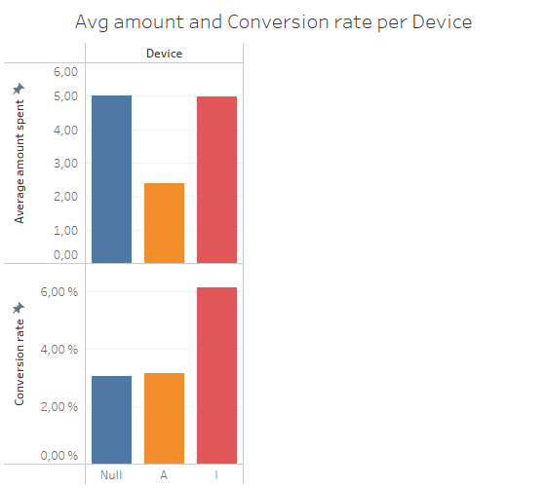
Device
Percentage difference between the groups of 18%

Slide 6
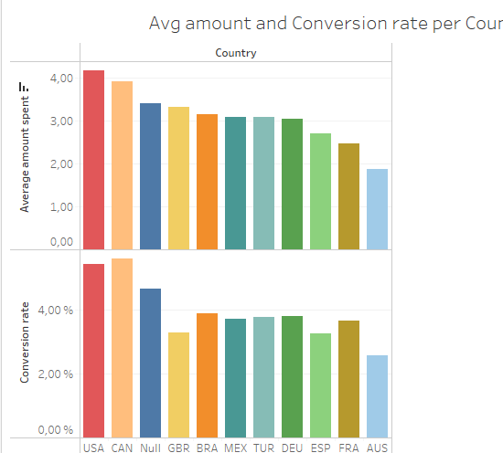
Country
Percentage difference between the groups of 18%

Slide 7
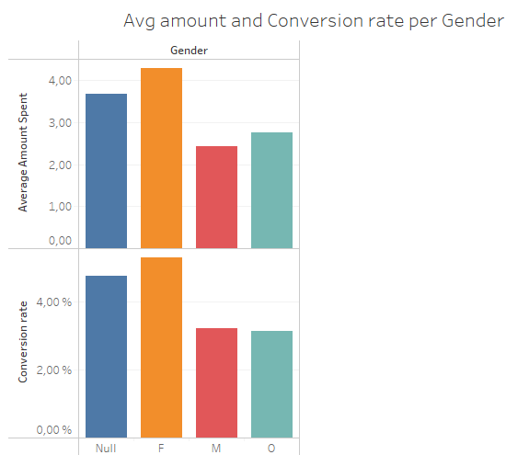
Gender
Percentage difference between the groups of 18%

Slide 8
Distribution of amount spend per user
No significant difference in amount spent by group

Slide 9
Recommendations
I recommend launching generally Group B presented significantly better results compared to group A
The new feature is at low cost hence a positive cost benefit
I would recommend a bigger sample and longer period

Slide 10

Thank you

